Slide 1


Slide 2


Slide 3
Click to see what you pick up.
ball
book
blanket
shoes
bear
cars

Slide 4
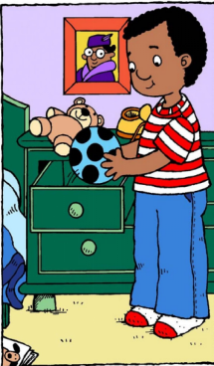
I pick up my ball.
return

Slide 5
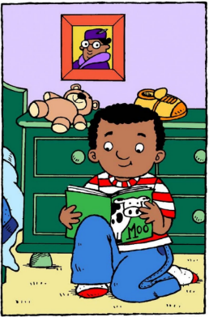
I pick up my book.
return

Slide 6
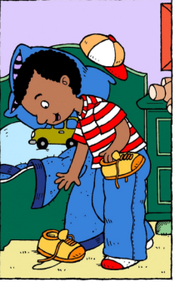
I pick up my shoes.
return

Slide 7
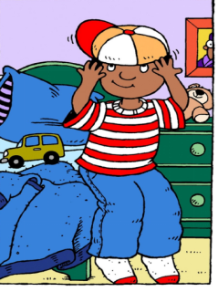
I pick up my hat.

Slide 8
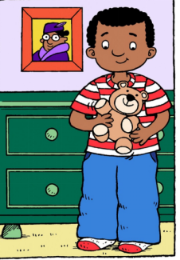
I pick up my teddy bear.
return

Slide 9
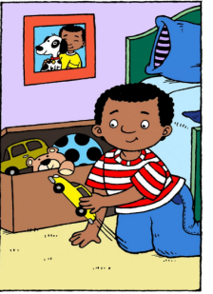
I pick up my teddy cars.
return

Slide 10
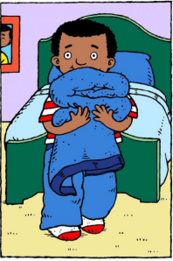
I pick up my blanket.
return

